Slide 1

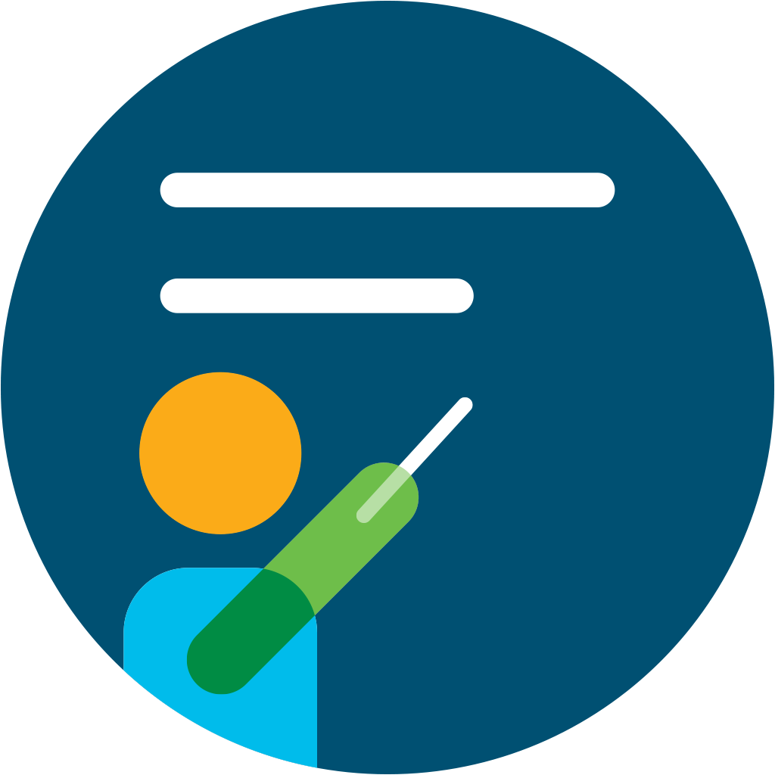


[Insert survey QR code survey URL]
OR
[Survey URL]
What do you do for yourself in order to keep healthy body and healthy mind?
Notes:
Jeff & Joanna

Slide 2

Session 1: Your Physical Layer: Healthy Body, Healthy Mind
Full Stack Wellness & Inclusion Series
Notes:
Thank you Joanna and Jeff for opening our session!
We are super happy to have you here and welcome to our first session which is part of a wider FullStack Wellness & Inclusion Series! Today we will talk about your physical layer - which is - essentially keeping healthy body and healthy mind!

Slide 3





Agenda
Intro
How does it connect with a bigger picture?
Our DevRel Story
How our team members keep healthy body and healthy mind?
Start change NOW
How <your organization> supports our wellbeing?
Let’s talk!
Tell us about your routines and how you started them, or why you do not have them and what makes it difficult to start.
DevRel Healthy Body, Healthy Mind challenge
More information about our steps challenge!
Notes:
As you can see in the agenda we have a few topics to cover during this session:
Just to give you a little bit of a heads up we will give you some additional context around the concept of this series , then we will have our one and only Stuart Clark share his story about how he is keeping his body and mind healthy and how it helps him in his day to day live!
Then we will have our great guest - Natalia Nowak, who is part of our Cisco health & wellbeing team and Natalia will tell you a little bit more about all the tools and tips that Cisco offers in order to support our well being.
Then we will tell you a little bit more about our DevRel Healthy Body, Healthy Mind Challenge.
Following that we will have our live Q&A with Grace and Ryan
- please bear in mind that we want to keep this session as interactive as possible, so if you have any questions - please send them in the chat! We will monitor them and either answer via chat or will bring them up during our Q&A’s!

Slide 4
Our Full Stack Wellness & Inclusion Series
CI/CD pipeline for your best self I am in an environment where I can thrive, be creative, and express myself authentically. I want to help others do the same.
Self- Actualization Needs
Personal Code Reviews: Owning and Honoring our Achievements
I am in a team where I can support others, and I feel comfortable asking for support when I need it.
Esteem Needs
Developing a team where everyone belongs I am in an environment where I can express who I am and how I feel.
Love/Belonging Needs
Designing a team where everyone feels safe I am not scared to be myself in my workplace. I feel safe here.
Safety Needs
Your Physical Layer: Healthy Body – Healthy Mind: We can't take care of others if we don't take care of ourselves
Physiological Needs
Notes:
As some of you may remember from our December AllHands - we have mentioned that our Full Stack Wellness & Inclusion Series is based on the concept developed in 1943 by American psychologist - Abraham Maslow. Even though this model has been developed many years ago - the key principles are still very relevant today.
The hierarchy of needs is split between deficiency needs and growth needs. (Up until esteem needs - these are deficiency needs and everything above are growth needs). When creating our series, we really wanted to show you, how crucial it is for each one of us to put yourself first.
Why? There is a lot of research out there that says How Trying to Make Everyone Happy Can Make You Miserable. And this is why we are here today - to remind you that before you will try to make the world a better place, you need take a look at yourself, and most importantly - take care of yourself. Today’s session - hopefully - will give you some tools and knowledge to start thinking about these changes.

Slide 5
Our Story
How our team members keep healthy body and healthy mind?

Slide 6

You At Your Best
Our definition of
PHYSICAL Wellbeing
EMOTIONAL Wellbeing
SOCIAL Wellbeing
FINANCIAL Wellbeing
The Whole You
Notes:
What do we mean when we talk about “The Whole You” – this is You at Your Best – at home and at work. If we can all find ways to make small changes and focus on each of these areas of wellbeing in our lives, we will be stronger as individuals and as teams.
Physical Wellbeing is not just about diet and exercise – it is the simplicity of moving throughout the day – getting out of our heads and into our body. Focusing on our preventative health and self-care and really taking time out to rest and recharge on a regular basis – sleep and time off from work is so important for building resilience!
Emotional Wellbeing – our focus on our mental health is just as important as our physical health. We need to concentrate on ourselves in order to be there for those around us. Don’t feel isolated and connect regularly with family, friends and perhaps a purpose you have in life. Seek help when needed and be open, aware and inclusive with one another.
Our Social Wellbeing is all about our connections. It is how we bring Our Principles to life each day, sharing stories, celebrating moments and really getting to know each other and giving back to our communities.
Financial Wellbeing is perhaps a new dimension to think about here, however such an important one. Throughout our lives we have expected and unexpected things happening to us where we may have wished we had been more planful of our finances to alleviate unnecessary stress and pressure. If we can be more aware and educate ourselves, we can address immediate needs and also plan for the future. It is important to optimise our benefit options available to us as well and understand how they can help with this planning.
Life can be pretty complicated though and each and every one of us will have something going on that others may not know. Through the power of The Four Elements – Eat, Sweat, Think and Connect we can focus on it’s simplicity to make some small, sustainable changes that help us all become more aware, resilient and able to deal with life’s ups and downs.

Slide 7

Wellbeing
TIPS
Keep your goals small
Set your boundaries and share them
Write 3 things you are grateful for each day
Be kind to yourself and to others
Notes:
Keep your goals small
Be kind to yourself and to others
Get more sleep
Be in the moment and self aware
Practice breathing techniques
Schedule downtime to recharge
Ask for help - connect with loved ones
Set your boundaries and share them
Get creative with your time
Try something new
Take a walk, get into nature
Remember: You are doing your best
Be curious, find accountability partners
Help others, give something of yourself
Set small intentions for yourself
Write 3 things you are grateful for
Manager Tips
Role model healthy behaviours – tell your teams when you are taking time away from work
Let people know what your personal boundaries are – time for movement, children, caring, giving back
Use Team Space to share your well-being priority - ask your teams to do the same
Take time for YOU – in order to be there for others at work and home you need to ensure you take time for your own well-being and resilience
Rest and recharge – ensure you are taking regular breaks – particularly during the shutdown and let's make a commitment not to connect on work topics unless absolutely critical
Show kindness and compassion – be authentic and understanding. Many people will be dealing with a lot right now and they may not share – create a safe space for this
Remember that different people, need different things at different times – understand this and be empathetic of others

Slide 8
wellbeing offerings
[List your company’s Wellbeing offerings here]

Slide 9
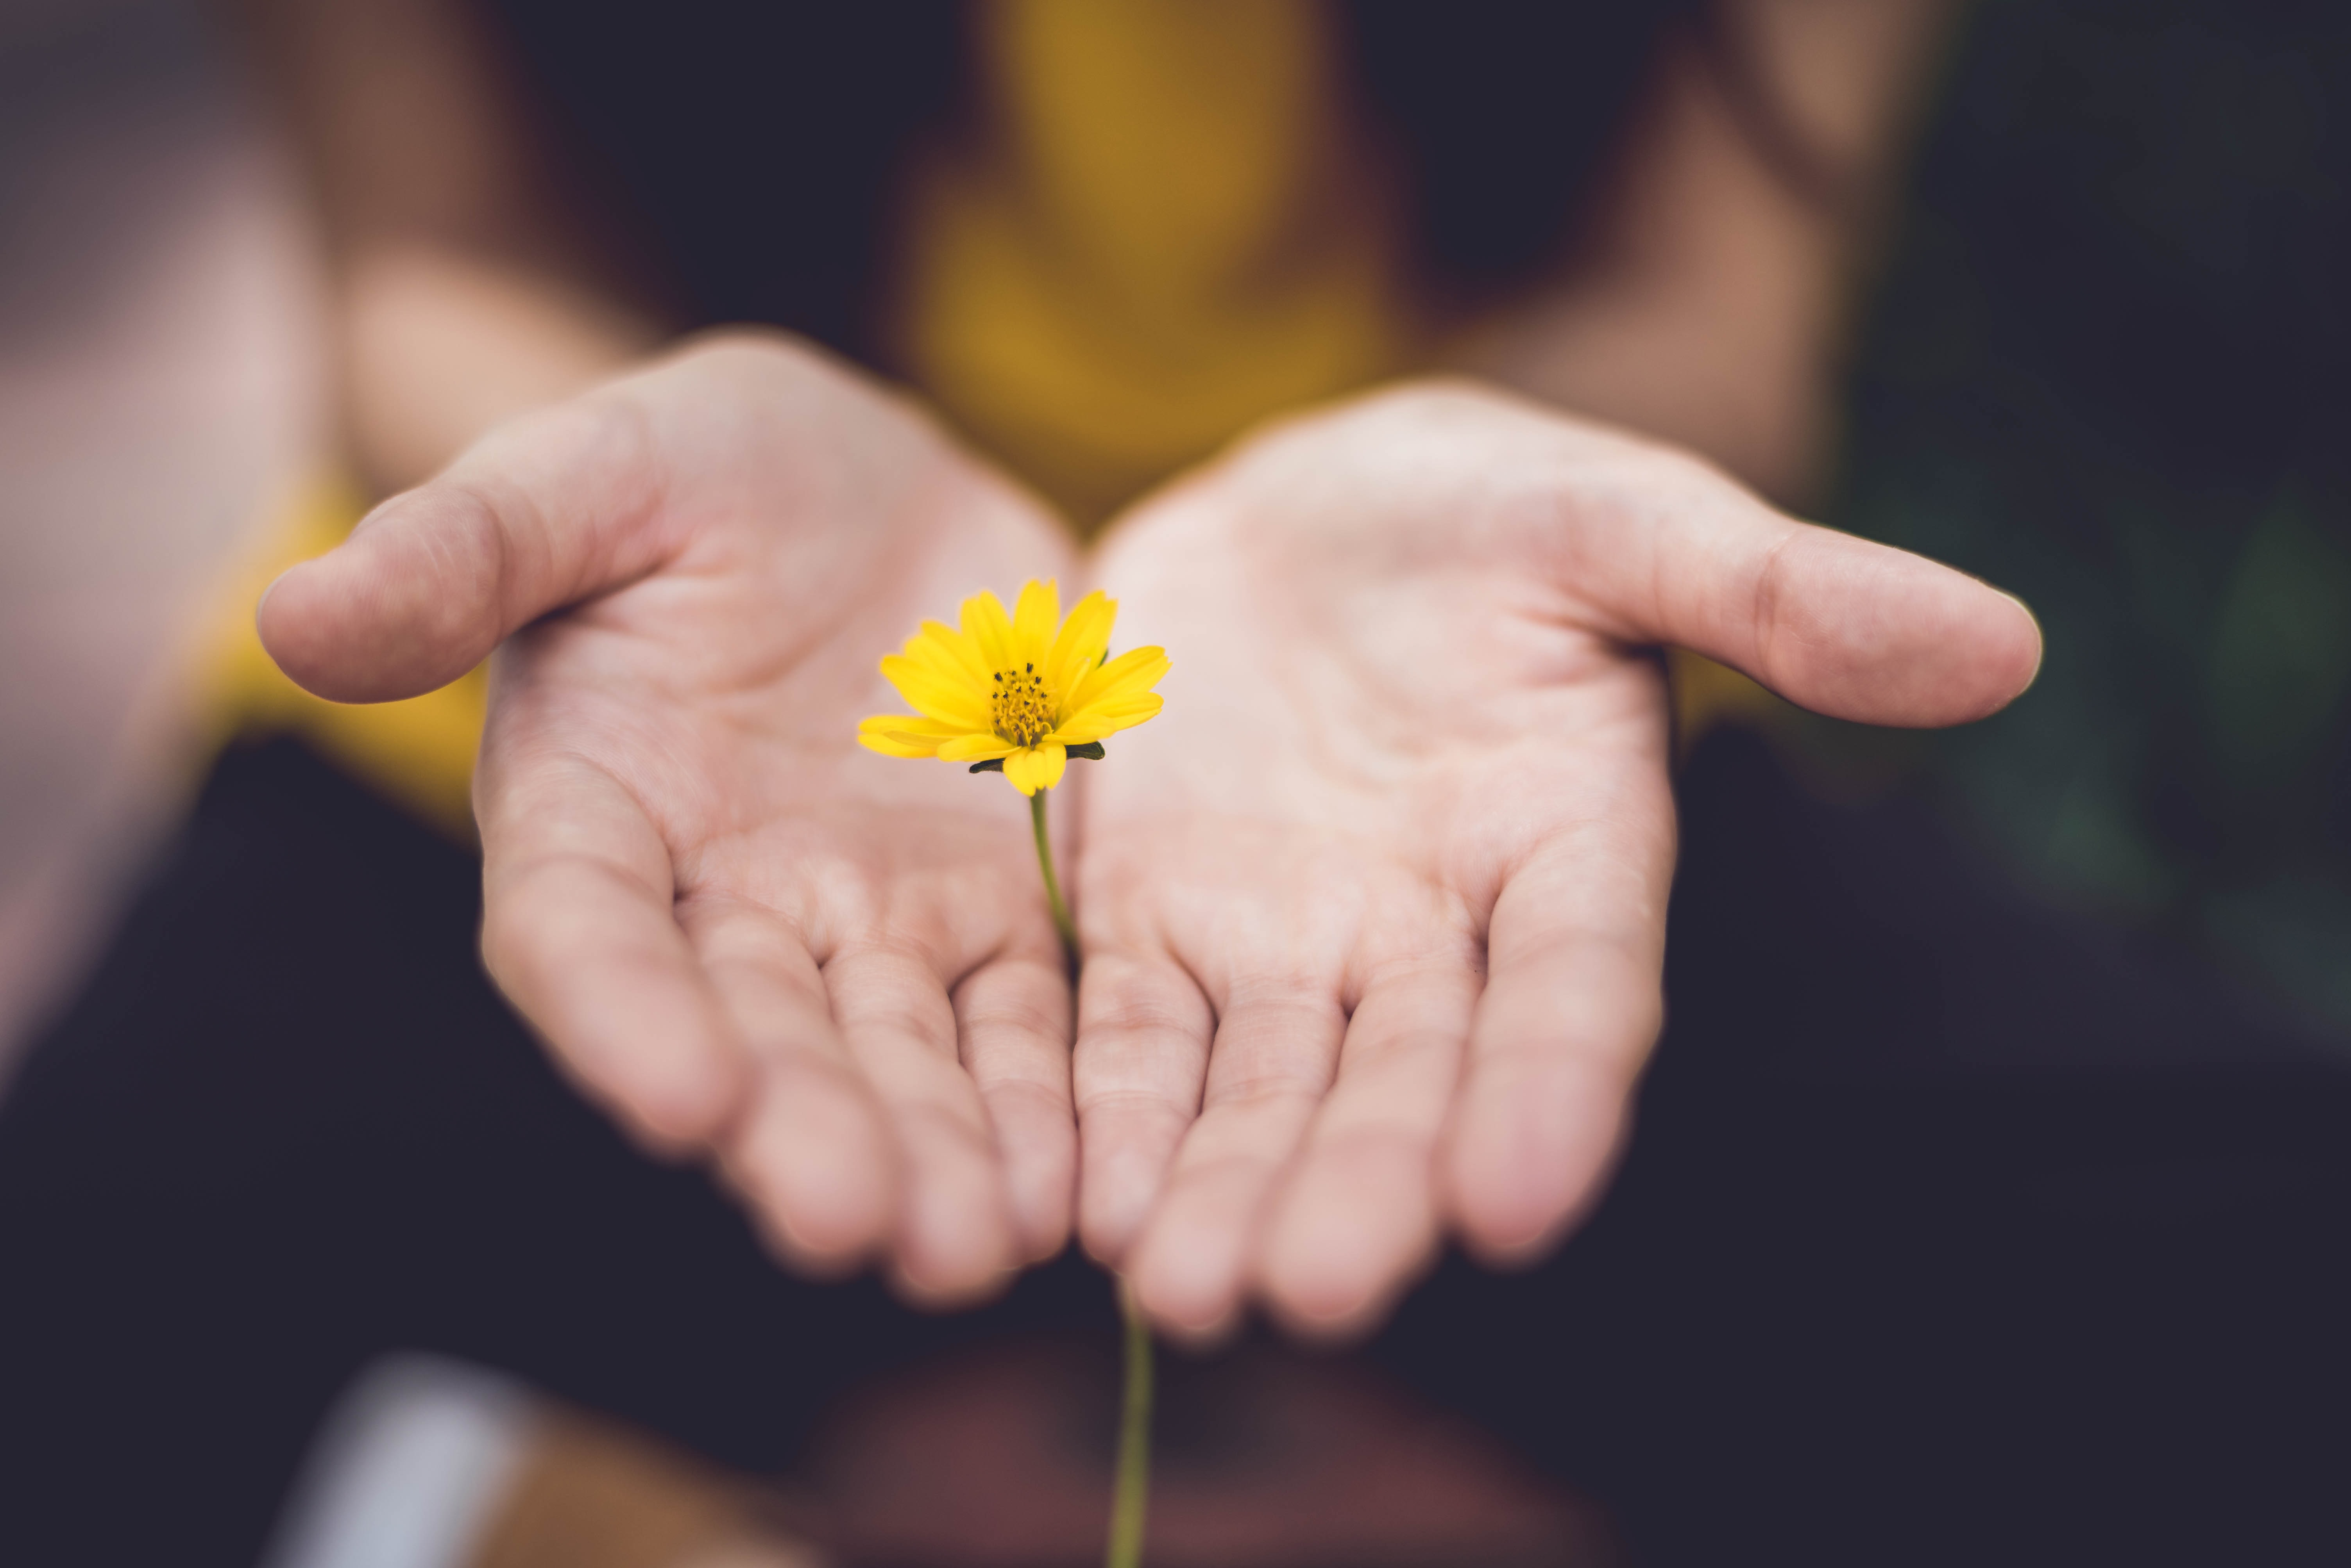



Wellbeing is
one click away

Slide 10
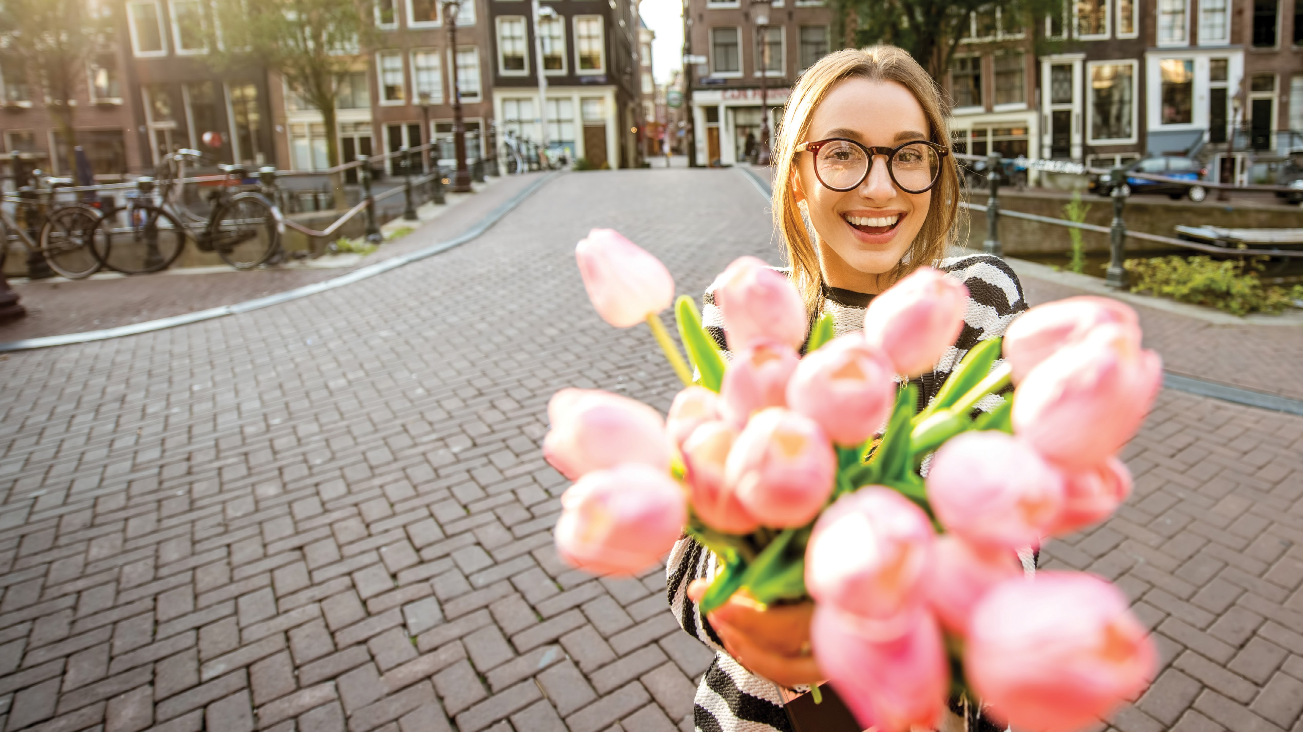
One small choice can cause a smile…
or change a life

Slide 11
[Insert survey QR code survey URL]
OR
[Survey URL]
What kind of a small change will you make as the result of this session?
Notes:
Jeff and Joanna

Slide 12

Healthy Body, Healthy Mind Challenge
DevRel Be Active Challenge!

Slide 13
Calls to Action:
Start changing your routine now – small steps matter
Tell us how we can support you
Learn more about <your organization> health & wellbeing initiatives
Visit our D&I site for all the latest updates
Notes:
Janel

Slide 14

Creating a team where everyone thrives
Bi-Weekly Stand Up:
Check-in Activity
<date>
Bi-Weekly Stand Up:
Check-in Activity
<date>
Bi-Weekly Stand Up:
Check-in Activity
<date>
Bi-Weekly Stand Up:
Check-in Activity
<date>
TBC…
Session 1: Your Physical Layer: Healthy Body, Healthy Mind
Session 2: Designing a Team Where Everyone Feels Safe
Session 3: Developing a Team Where Everyone Belongs
Session 4: Team Code Reviews: The Art of Giving and Receiving Support
Session 5: CI/CD Pipeline for Your Best Self
Kick Off Session: Full Stack Wellness & Inclusion
Today
Today + 1 month
Today + 2 months
Today + 3 months
Today + 4 months
Notes:
Erin

Slide 15
DO NOT USE
[Q& A with executive sponsor ]
Notes:
Question 1: What do you see are the personal benefits of having a strong mind-body connection?
Question 2: What are some of the activities you do to care for your physical health? How do they support a healthy mind-body connection?
Question 3: Can you walk us through your daily routine to keep your mental and physical health in top share?
Question 4: The pandemic changed so much of how we lived -- it placed new demands on mental health and also changed how we are active? How did you accommodate to keep your physical and mental health a priority?
Question 5: What recommendations would you share with the team?
Question 6: Any closing thoughts on this session or the series we are embarking on? (Just your final thoughts)

